Slide 1
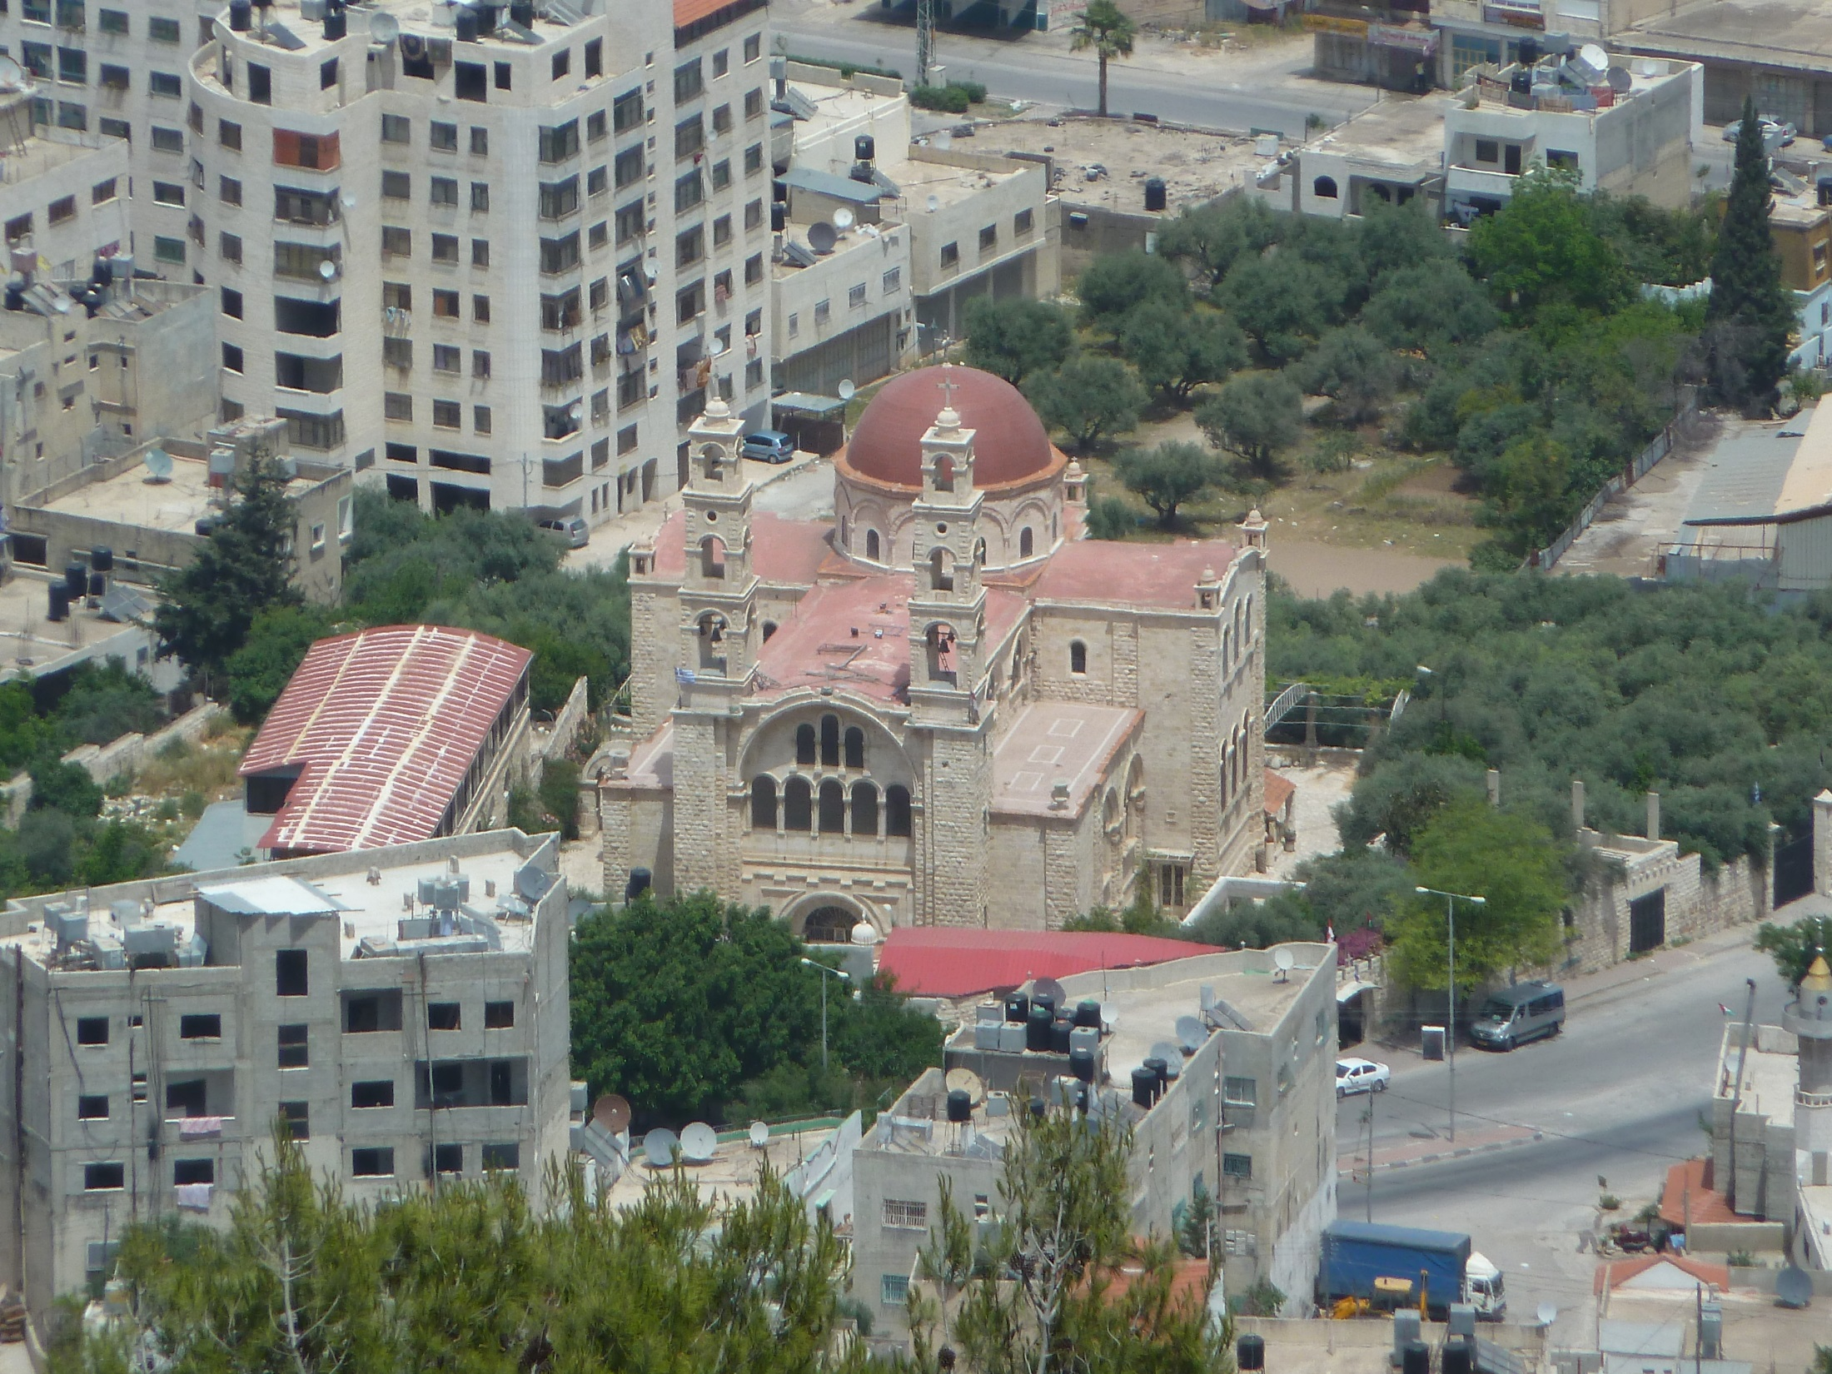
John 4.1-42
This Church marks the spot of Jacob’s well.
This area now is a hotbed of Muslim terrorism.

Slide 2
John 4.1-3 [NET]: Now when Jesus knew that the Pharisees had heard that he was winning and baptizing more disciples than John (although Jesus himself was not baptizing, but his disciples were), he left Judea and set out once more for Galilee.
Map from Schlegel’s Satellite Bible Atlas

Slide 3
John 4.4-6: But he had to pass through Samaria. Now he came to a Samaritan town called Sychar, near the plot of land that Jacob had given to his son Joseph. Jacob's well was there, so Jesus, since he was tired from the journey, sat right down beside the well. It was about noon.
Map from Schlegel’s Satellite Bible Atlas

Slide 4
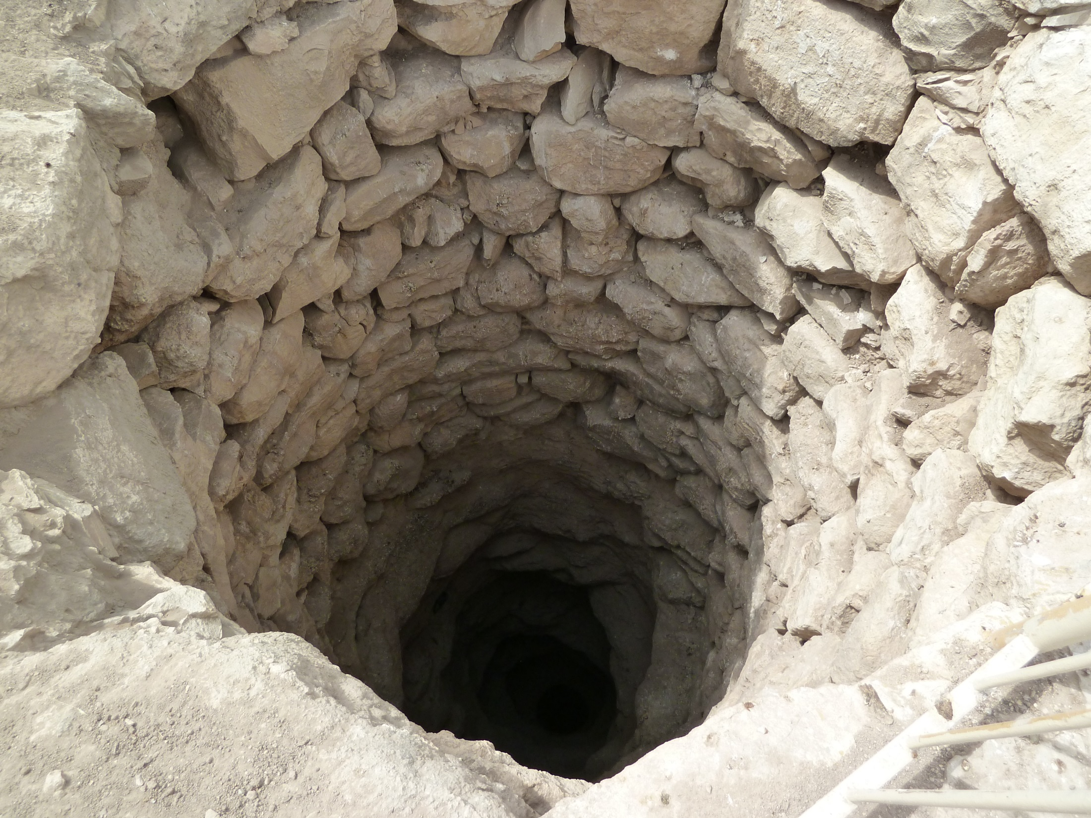
John 4.7-9: A Samaritan woman came to draw water. Jesus said to her, “Give me some water to drink.” (For his disciples had gone off into the town to buy supplies.) So the Samaritan woman said to him, “How can you– a Jew– ask me, a Samaritan woman, for water to drink?” (For Jews use nothing in common with Samaritans.)

Slide 5
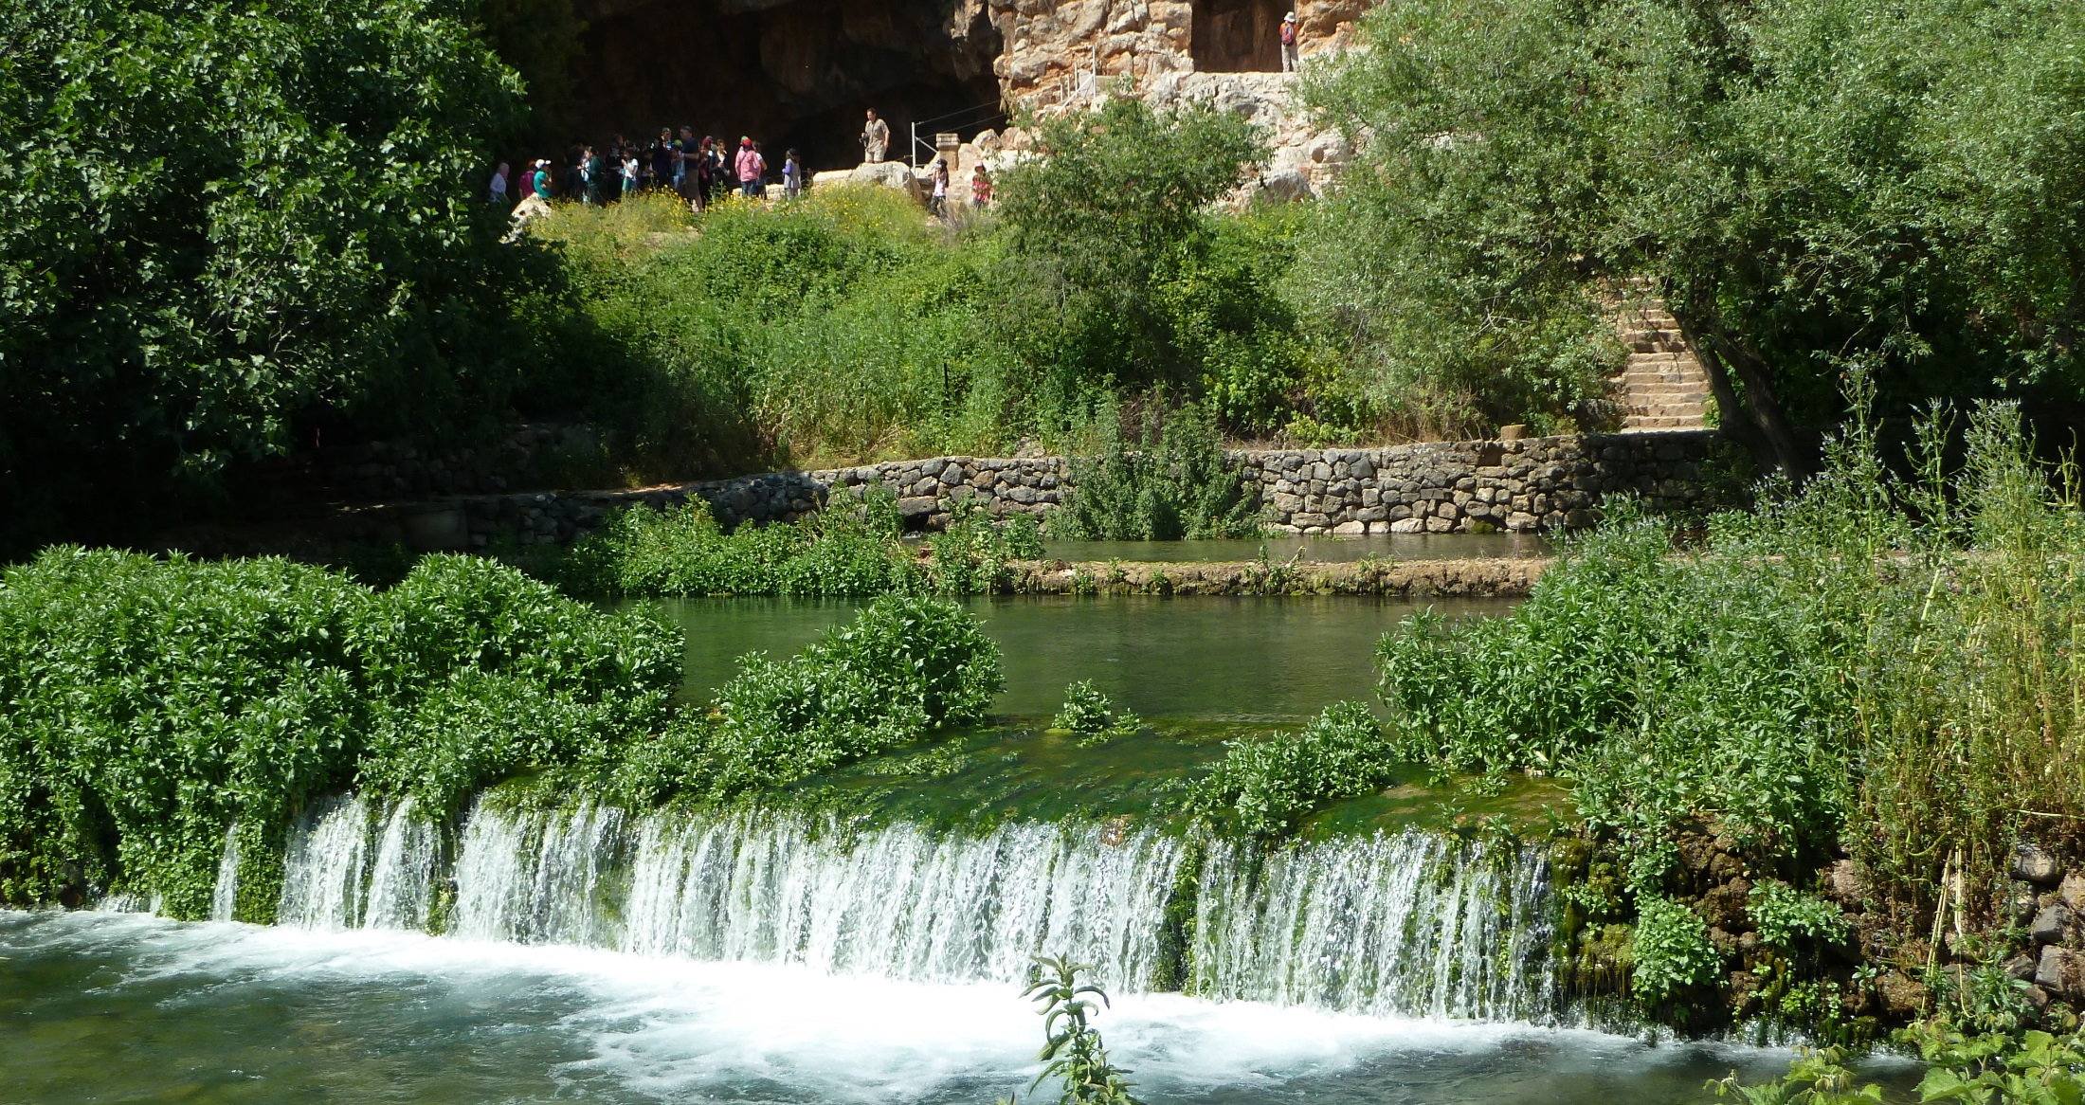
John 4.10-12: Jesus answered her, “If you had known the gift of God and who it is who said to you, ‘Give me some water to drink,’ you would have asked him, and he would have given you living water.” “Sir,” the woman said to him, “you have no bucket and the well is deep; where then do you get this living water? Surely you're not greater than our ancestor Jacob, are you? For he gave us this well and drank from it himself, along with his sons and his livestock.”

Slide 6
John 4.10: Jesus answered her, “… he would have given you living water.”
Jeremiah 2.13 [NIV]: “My people have committed two sins: They have forsaken me, the spring of living water, and have dug their own cisterns, broken cisterns that cannot hold water.”

Slide 7
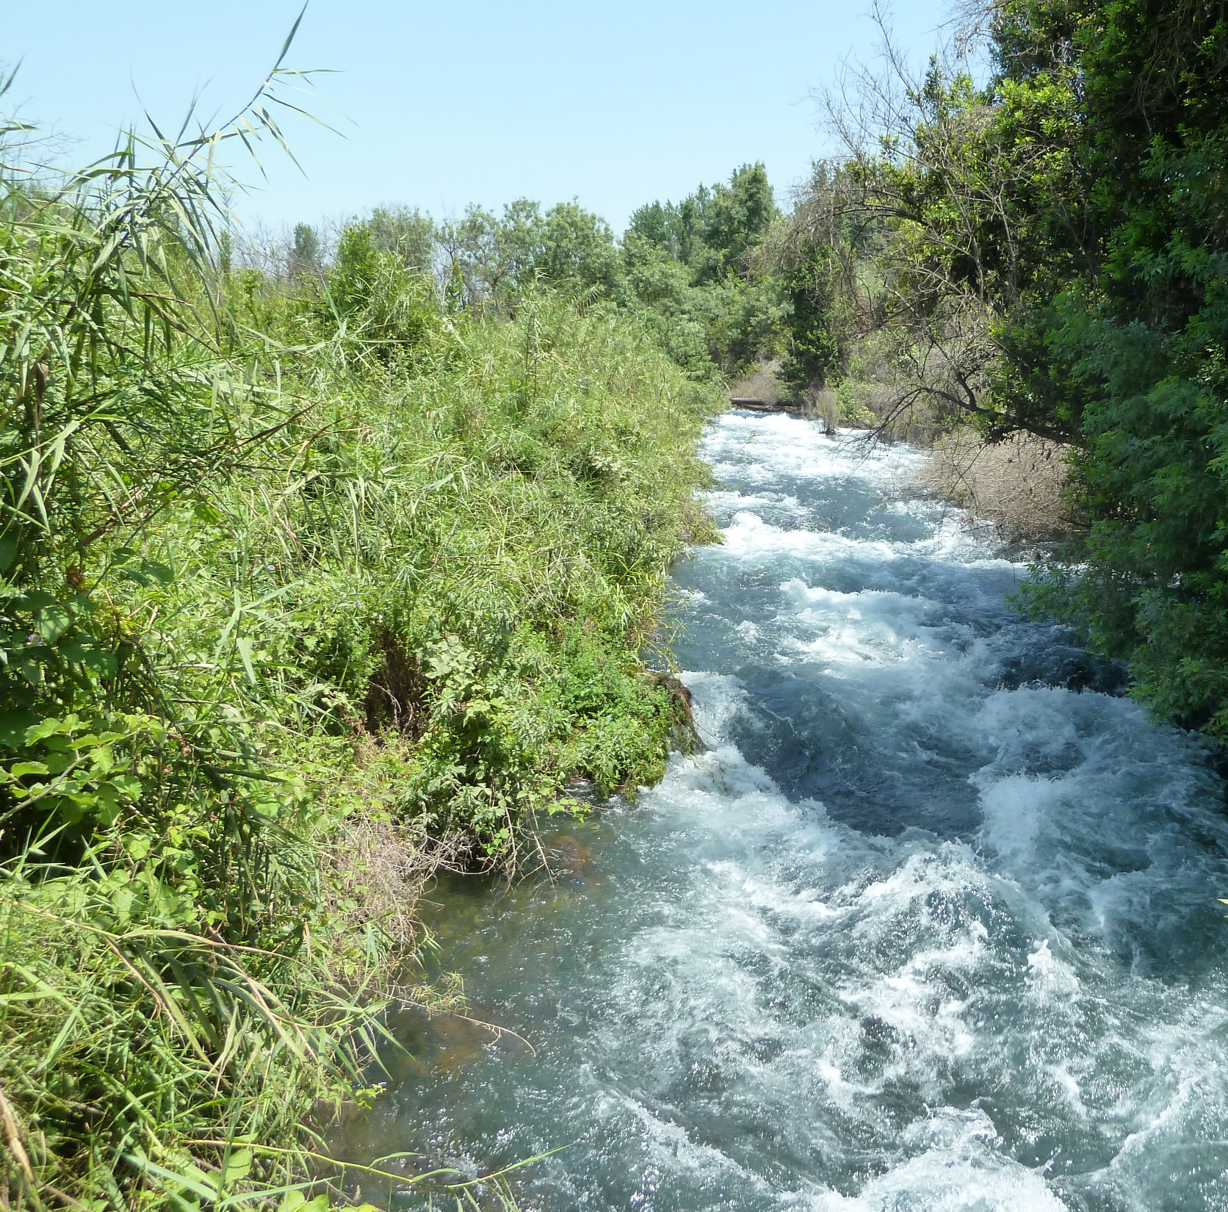
John 4.13-15: Jesus replied, “Everyone who drinks some of this water will be thirsty again. But whoever drinks some of the water that I will give him will never be thirsty again, but the water that I will give him will become in him a fountain of water springing up to eternal life.” The woman said to him, “Sir, give me this water, so that I will not be thirsty or have to come here to draw water.”

Slide 8
John 7.37-39 [NET]: On the last day of the feast, the greatest day, Jesus stood up and shouted out, “If anyone is thirsty, let him come to me, and let the one who believes in me drink. Just as the scripture says, ‘From within him will flow rivers of living water.’” (Now he said this about the Spirit, whom those who believed in him were going to receive...)

Slide 9
John 4.13-15: Jesus replied, “Everyone who drinks some of this water will be thirsty again. But whoever drinks some of the water that I will give him will never be thirsty again, but the water that I will give him will become in him a fountain of water springing up to eternal life.” The woman said to him, “Sir, give me this water, so that I will not be thirsty or have to come here to draw water.”

Slide 10
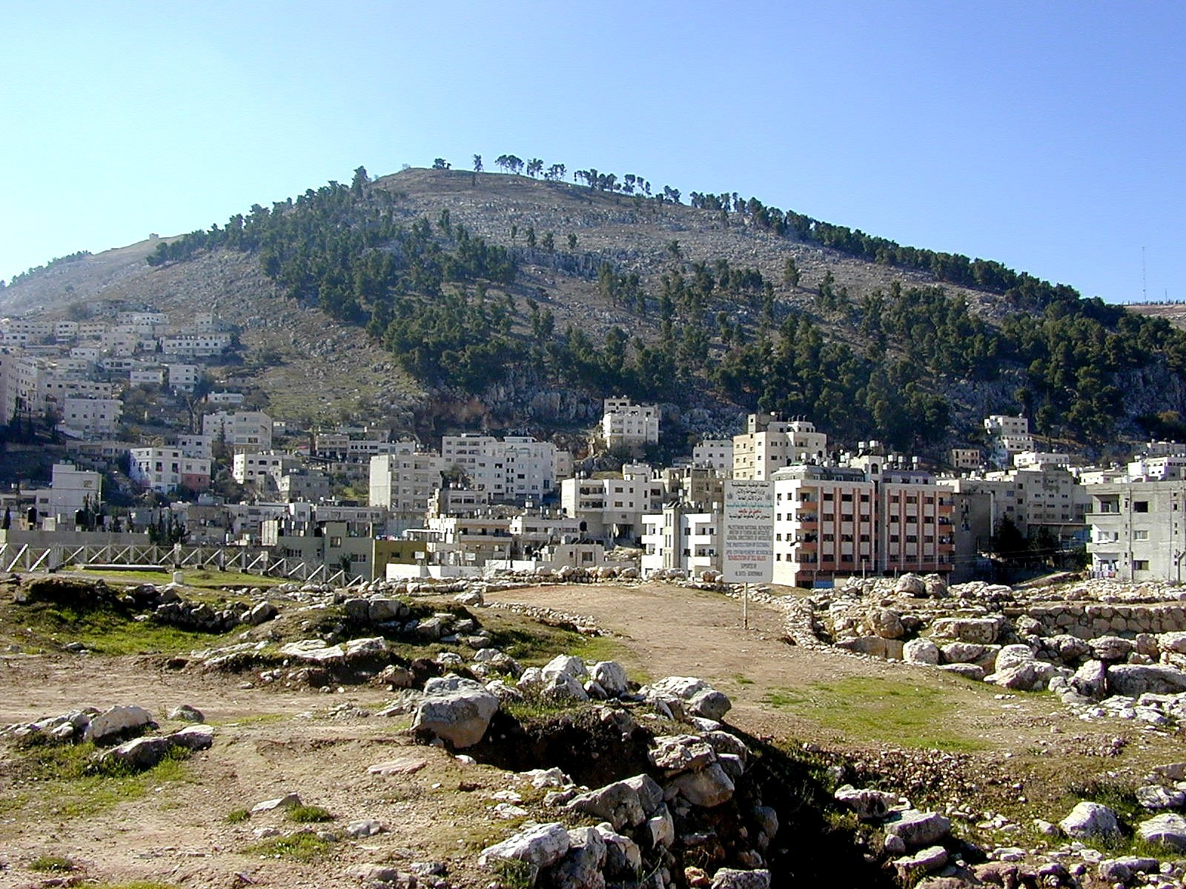
John 4.16-18: He said to her, “Go call your husband and come back here.” The woman replied, “I have no husband.” Jesus said to her, “Right you are when you said, ‘I have no husband,’ for you have had five husbands, and the man you are living with now is not your husband. This you said truthfully!”
Mt. Gerizim photo courtesy of Todd Bolen
©2006 Pictorial Library of Bible Lands / www.BiblePlaces.com

Slide 11
John 4.19-20: The woman said to him, “Sir, I see that you are a prophet. Our fathers worshiped on this mountain, and you people say that the place where people must worship is in Jerusalem.”
Mt. Gerizim photo courtesy of Todd Bolen
©2006 Pictorial Library of Bible Lands / www.BiblePlaces.com

Slide 12
John 4.21-24: Jesus said to her, “Believe me, woman, a time is coming when you will worship the Father neither on this mountain nor in Jerusalem. You people worship what you do not know. We worship what we know, because salvation is from the Jews. But a time is coming– and now is here– when the true worshipers will worship the Father in spirit and truth, for the Father seeks such people to be his worshipers. God is spirit, and the people who worship him must worship in spirit and truth.”

Slide 13
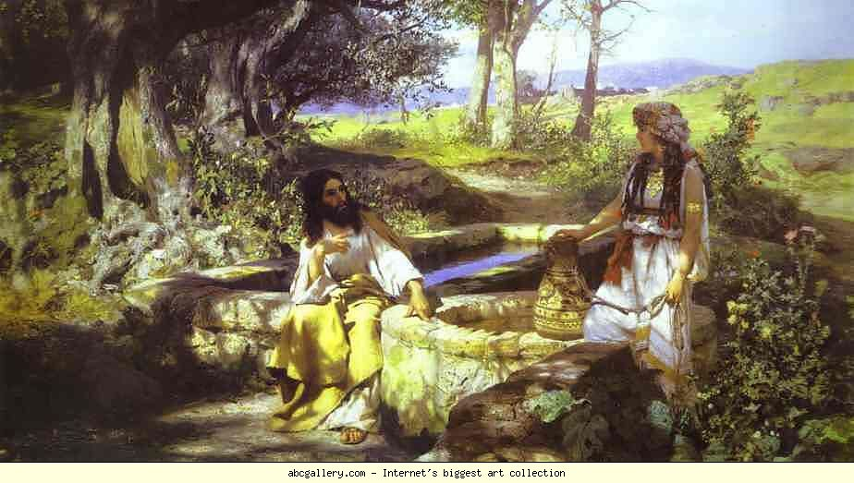
John 4.25-26: The woman said to him, “I know that Messiah is coming” (the one called Christ); “whenever he comes, he will tell us everything.” Jesus said to her, “I, the one speaking to you, am he.”
“Christ and the Samaritan Woman” Henryk Siemiradzki abcgallery.com

Slide 14
John 4.27-30: Now at that very moment his disciples came back. They were shocked because he was speaking with a woman. However, no one said, “What do you want?” or “Why are you speaking with her?” Then the woman left her water jar, went off into the town and said to the people, “Come, see a man who told me everything I ever did. Surely he can't be the Messiah, can he?” So they left the town and began coming to him.

Slide 15
John 4.31-35: Meanwhile the disciples were urging him, “Rabbi, eat something.” But he said to them, “I have food to eat that you know nothing about.” So the disciples began to say to one another, “No one brought him anything to eat, did they?” Jesus said to them, “My food is to do the will of the one who sent me and to complete his work. Don't you say, ‘There are four more months and then comes the harvest?’ I tell you, look up and see that the fields are already white for harvest!”

Slide 16
John 4.36-38: “The one who reaps receives pay and gathers fruit for eternal life, so that the one who sows and the one who reaps can rejoice together. For in this instance the saying is true, ‘One sows and another reaps.’ I sent you to reap what you did not work for; others have labored and you have entered into their labor.”

Slide 17
John 4.39-42: Now many Samaritans from that town believed in him because of the report of the woman who testified, “He told me everything I ever did.” So when the Samaritans came to him, they began asking him to stay with them. He stayed there two days, and because of his word many more believed. They said to the woman, “No longer do we believe because of your words, for we have heard for ourselves, and we know that this one really is the Savior of the world.”

Slide 18
Spiritual Life
Inspires
Gives
Jesus = Christ
Inspires
Evangelism
Desires
Inspires
True Worshippers

